Slide 1
HTML Form and Controls I
Week 01.

Slide 2
Objectives
Describe the structure of a form in a HTML document;
Describe the syntax and characteristics of HTML form elements;
Demonstrate how to create navigation links in a web page;
Demonstrate how to create a simple form in web page.

Slide 3
Tools Required
Visual Studio Code
Browser
Google Chrome (recommended)
Mozilla Firefox

Slide 4
CREATING lISTS

Slide 5
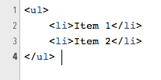
Unordered Lists
Item 1
Item 2

Slide 6
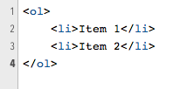
Ordered Lists
Item 1
Item 2

Slide 7
Creating Links

Slide 8
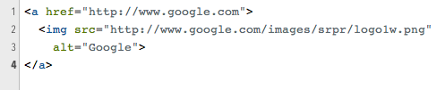
Link to External Website
Google
Google
Should external links open in new tab?
Opens Google website in a new browser window / tab
Notes:
Click on the sentence “Should external links open in new tab?” to open to article.

Slide 9
Target Values
Target Value | Description
_blank | Opens the linked document in a new window or tab
self | Opens the linked document in the same frame as it was clicked (this is default)
_parent | Opens the linked document in the parent frame
_top | Opens the linked document in the full body of the window
framename | Opens the linked document in a named frame

Slide 10
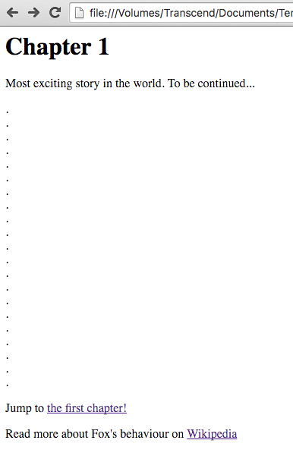
Link Within Page
<h1 id="chapter1">Chapter 1</h1>
<p>Most exciting story in the world. To be continued...</p> .<br>
.<br>
.<br>
.<br>
.<br>
.<br>
.<br>
.<br>
.<br>
.<br>
.<br> .<br>
.<br>
.<br> .<br>
.<br>
.<br>
.<br>
.<br>
.<br>
.<br>
<p>Jump to <a href="#chapter1">the first chapter!</a> </p>
<p>Read more about Fox's behaviour on
<a href="http://en.wikipedia.org/wiki/Fox#Behavior">Wikipedia</a>
</p>
Notes:
Copy the code on the left and paste into a blank HTML file to test.
Open it in a browser window.
Resize the browser window until only the “Jump to….” text is visible.
Click on the ”the first chapter!” link.

Slide 11
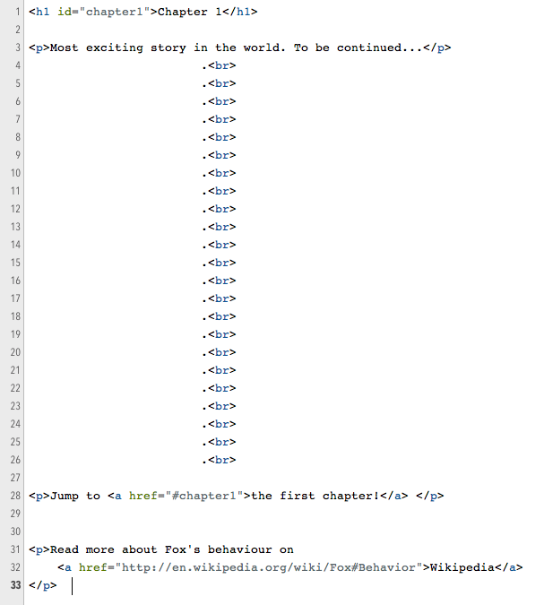
Link Within Page

Slide 12
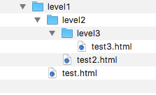
Link Within Own Website
From within test.html:
<p>Link to <a href=“level2/test2.html”>level 2</a>
From within test.html:
<p>Link to <a href=“level2/level3/test3.html”>level 3</a>
From within test2.html:
<p>Link to <a href=“../test.html”>level 1</a>
From within test3.html:
<p>Link to <a href=“../../test.html”>level 1</a>

Slide 13
Comments

Slide 14
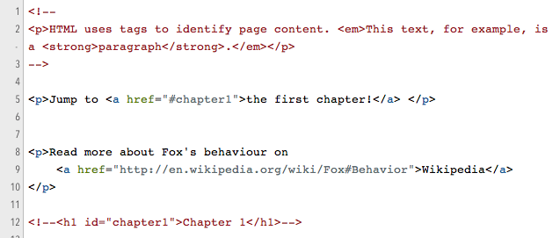
Comments In HTML
Start of comment
Comments will not be shown or rendered in web page.
End of comment

Slide 15
TABLES

Slide 16
Tables in HTML
Tables are useful for displaying tabular data on the web such as research study results.

Slide 17
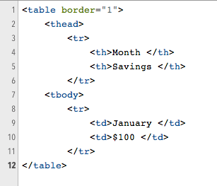

Adding Table
Table row
Header cell
Table header
Table body
Table data/column

Slide 18
FORMS

Slide 19
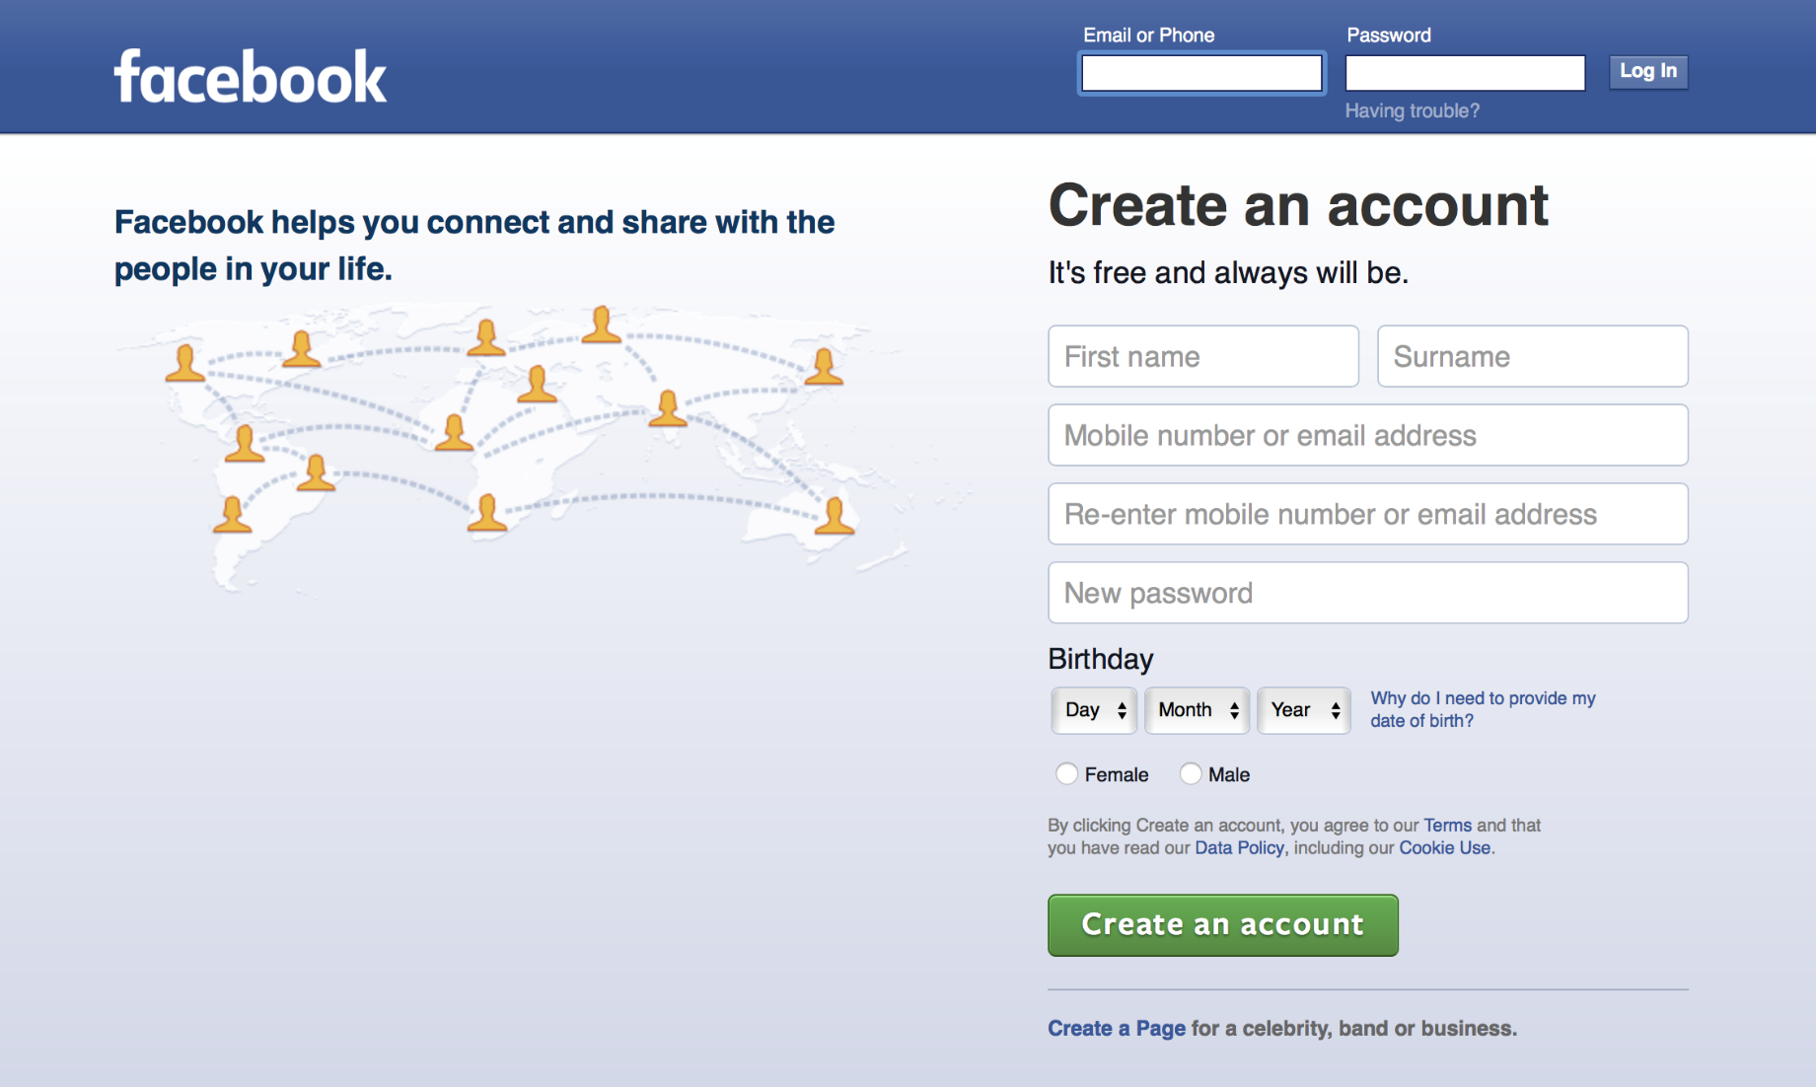
HTML Form

Slide 20
Client-to-Server Communication
Client (Browser)
Query String
Server

Slide 21
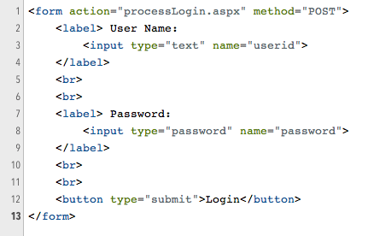
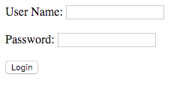
Form Structure
The web page where data in form are sent to for processing when the Login button is pressed.
How data in form are being sent: POST or GET
Input element to collect data in web page

Slide 22
challenge
W1.5 HTML Form and Controls I.docx

Slide 23
The End

